Slide 1
FEBRUARY 2015 US AIRLINE TWEETS

Slide 2
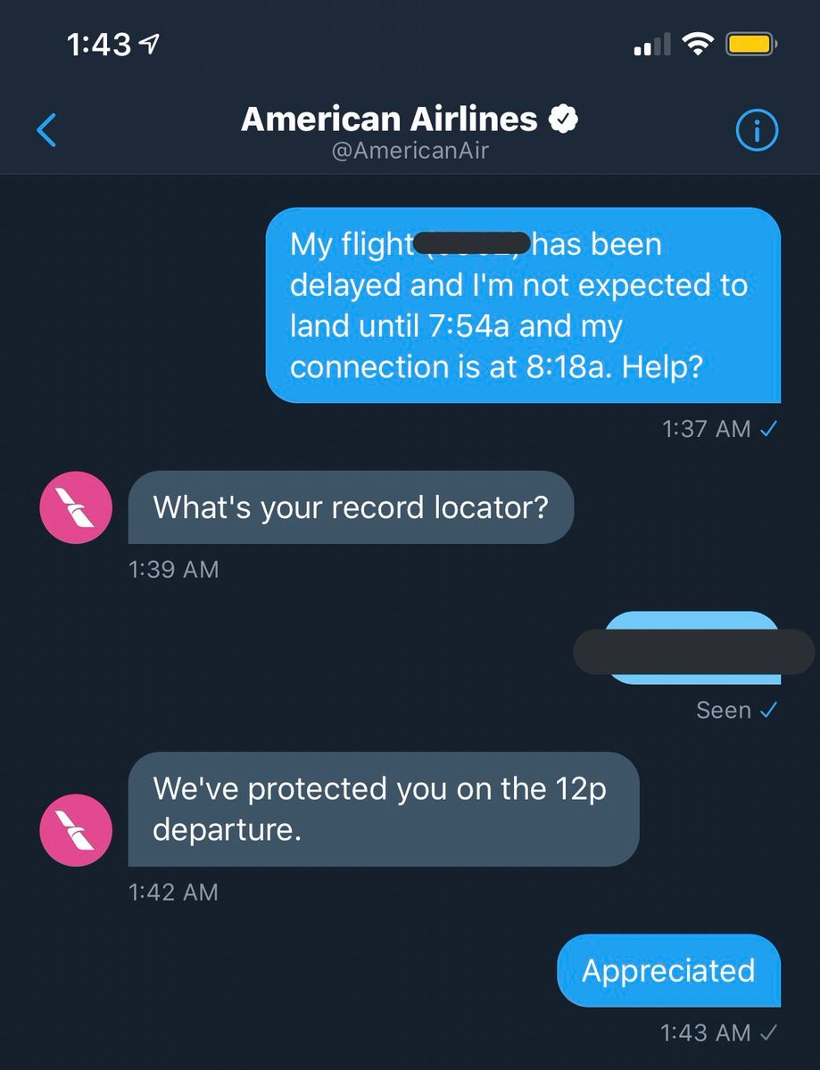
WANT FASTER AIRLINE CUSTOMER SERVICE?
TWEET OR DM
  24/7 Customer Service
  Faster Response Time
  Near 100% Response Rate

Slide 3
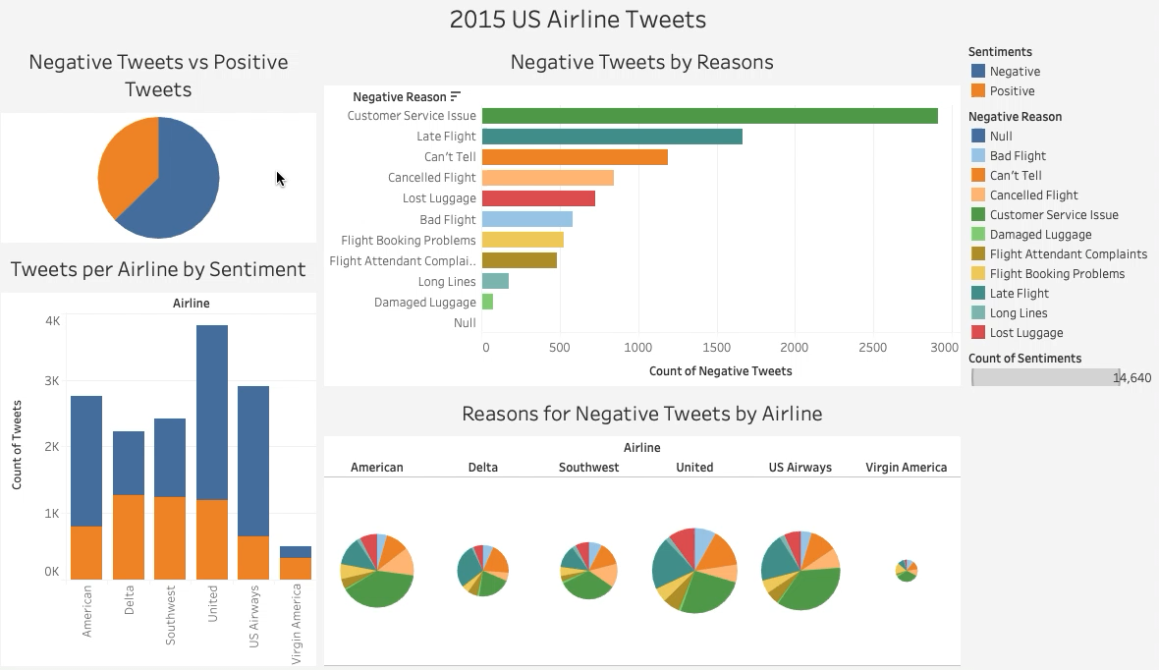
0 = Negatives (majority), 1 = Positives (minority)

Slide 4
TOPIC MODELING PROCESS
  Dataset:
    February 2015 US Airline Tweets from Kaggle
  Data Cleaning:
    Pre- Processing Text Pipeline:
      Remove Punctuations
      Remove Numbers
      Lowercase
      Remove Stop Words
    Feature Extraction: TF-IDF
  Topic Modeling:
    NMF

Slide 5
TOPICS BY SENTIMENT
TF-IDF (NGRAMS = 2)
NMF
  Negative:
    Flight Delays:
      flight delayed, delayed hours, connecting flight
    Flight Cancellations:
      flight cancelled, just cancelled, rebook help
    Customer Service Issues:
      customer service, worst customer, hold hours
    Unknown
  Positive or Neutral:
    Inquiries:
      follow dm, need follow, dm info
    Customer Satisfaction:
      customer service, great customer, dm sent
    Unknown

Slide 6
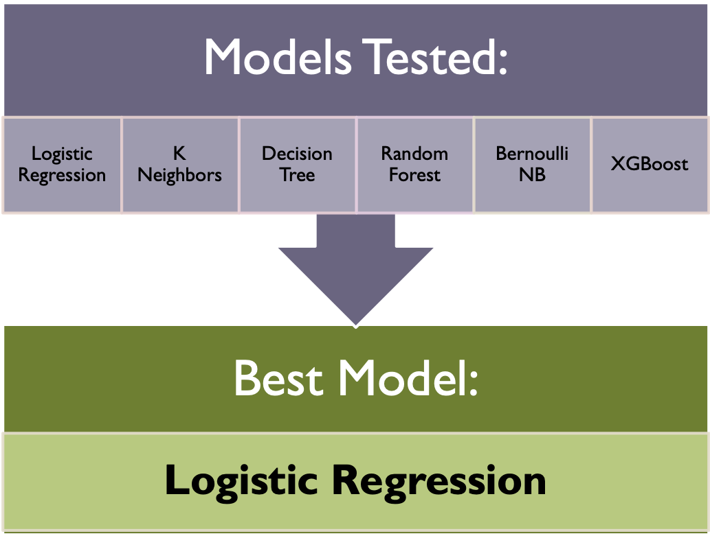
SENTIMENT ANALYSIS: CLASSIFICATION

Slide 7

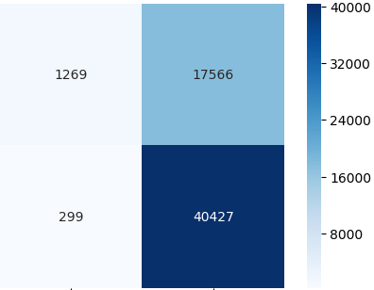
LOGISTIC REGRESSION (C=3.72) WITH TF-IDF (NGRAMS = 2)
Predicted Sentiments
Metrics:
F1 Score Weighted
Weighted F1 Test Score: 0.82
  F1 Test Score (Negative): 0.87
  F1 Test Score (Positive): 0.74
Negative
Positive
57.1%
6.9%
Negative
2485
299
Actual
Sentiments
10.7%
25.3%
Positive
467
1097

Slide 8
